Slide 1

Sani3i
Sani3i Application
Web site for help people

Slide 2
Team Of Sani3i
Kholoud Salama
Mahmoud Mustafa
Ahmed Ragab
Salma Yasser
Ali Siam

Slide 3

Sani3i
Introduction
The aim of this project is to develop a website that serves as a comprehensive platform for users to discover artisans in various industrial fields and the ease of booking an appointment with the technician with a profile specific to each technician and community to showcase their occupation and an assessment of the technician through the customer with the availability of the tools store they can buy the tools through.

Slide 4
Steps
Week 1
Week 2
Week 3
Week 4
: Initial Database Design and Migration
Model Implementation and Role-Based Access Control
Completing Models and Building Real-Time Chat.
building dashboard and final test.
Back to Agenda Page

Slide 5
Sani3i
Purpose
The platform aims to provide users with an easy and efficient way to discover artisans and technicians across various industrial fields. Users will be able to book appointments, view profiles of technicians (including their skills, past work, and client reviews), and purchase necessary tools and equipment from an integrated online store. Additionally, the platform will serve as a community hub where artisans can showcase their expertise and connect with potential clients.
Back to Agenda Page

Slide 6





Chat between user and Worker
Write a note here
Write a note here
!
Back to Agenda Page

Slide 7
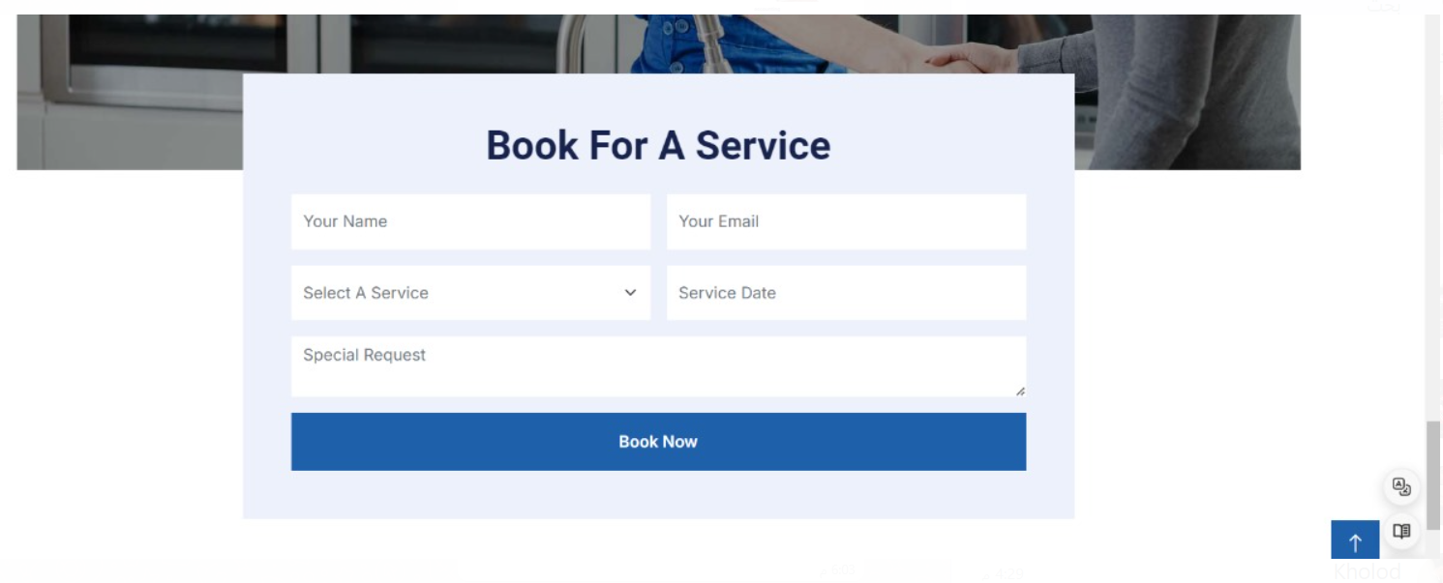
Add Order

Slide 8
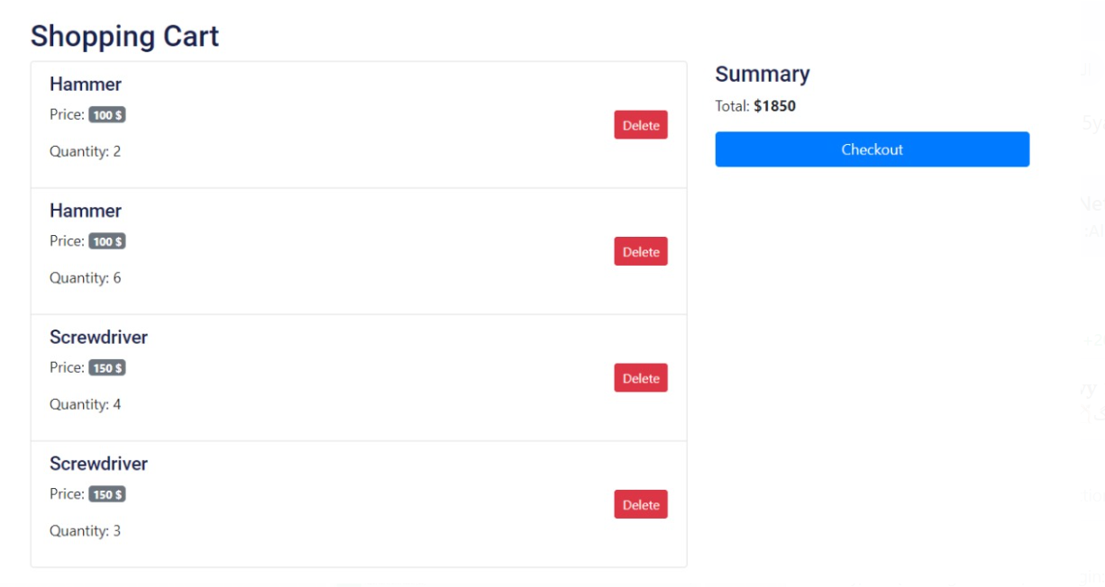
Shopping Cart

Slide 9
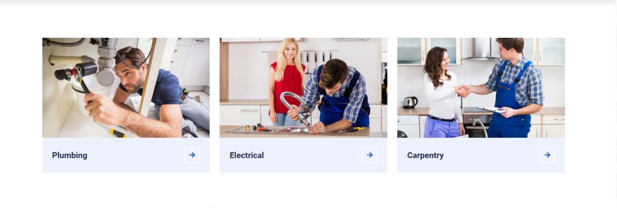
Craft

Slide 10
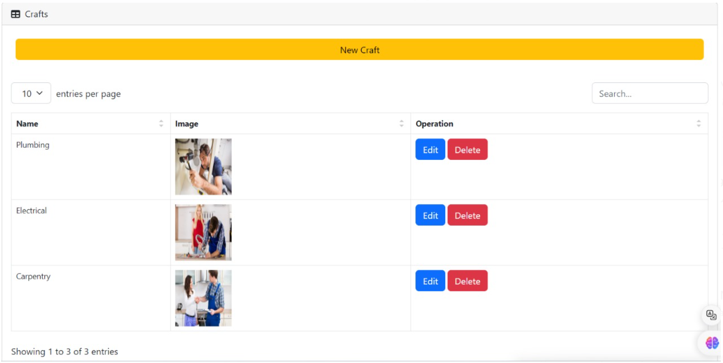
Craft Admin Dashboard

Slide 11
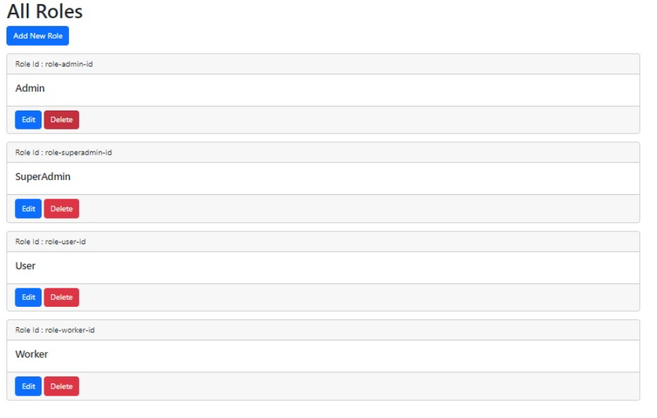
Admin Dashboard

Slide 12
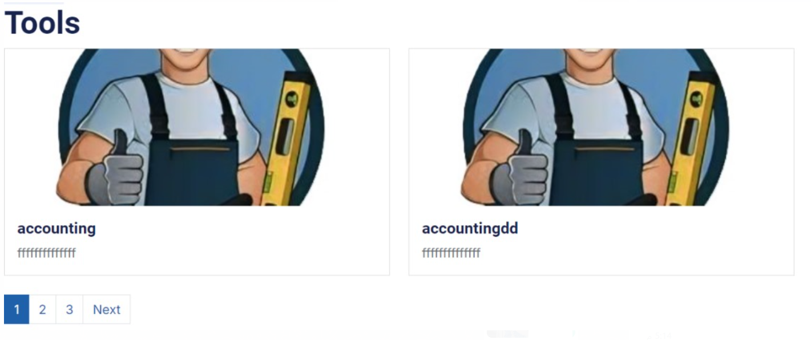
Tool With Pagination

Slide 13
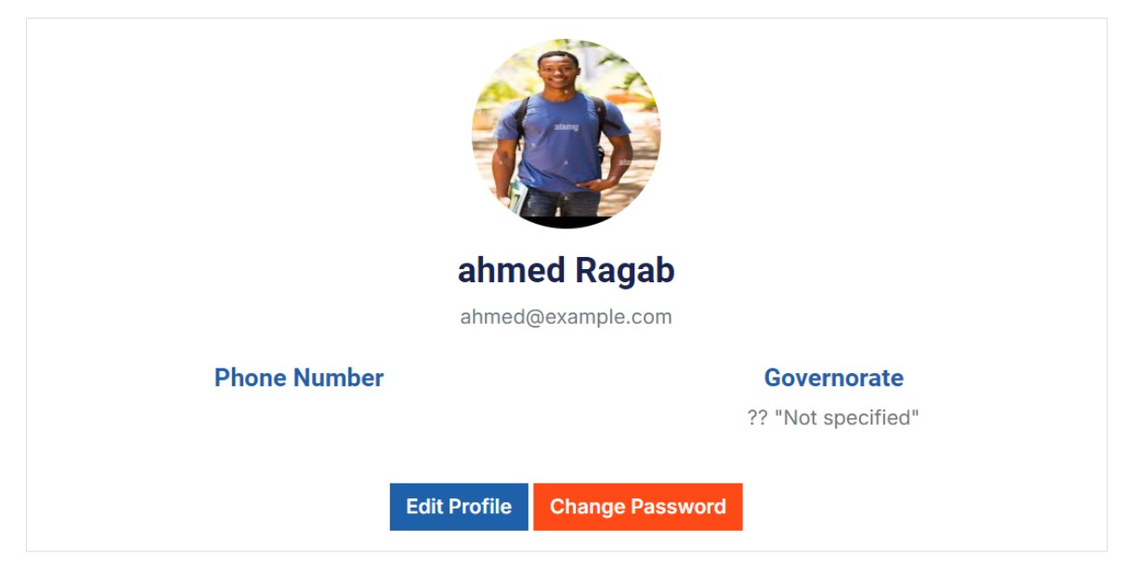
Profile

Slide 14
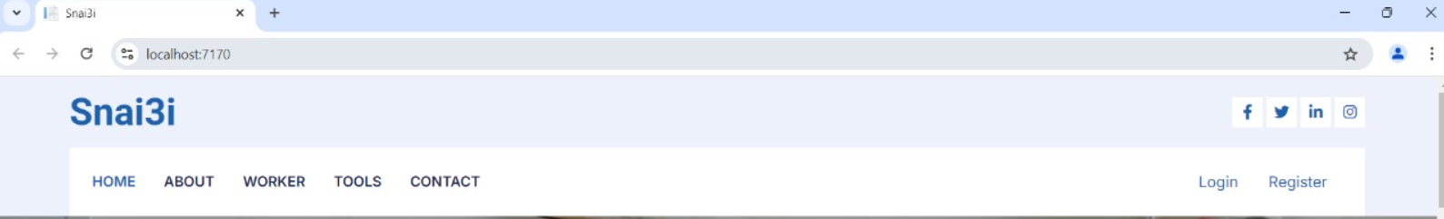
Web Header
This header contains a navigation bar with the following menu items: "HOME," "ABOUT," "WORKER," "TOOLS," and "CONTACT." On the right side, there are three icons representing a shopping cart, an envelope (likely for messages or email), and a user account dropdown. The logo at the top left says "Snai3i”

Slide 15


